Slide 1
LECTURE 3
INT-402(MODERN WEB TOOLS AND TECHNIQUES)

Slide 2
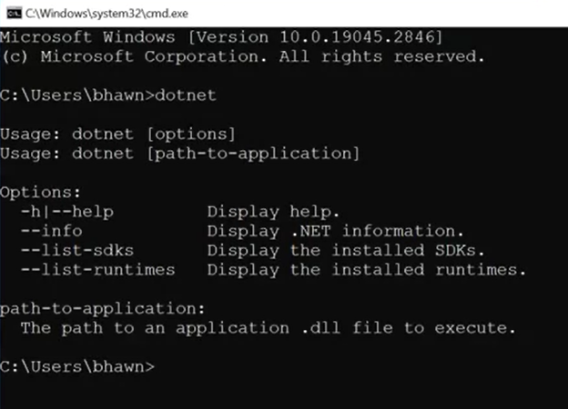
Setting up a development environment with VS code
Step 1: First of all, open the CMD, then write dotnet to see whether its installed in your system or not

Slide 3
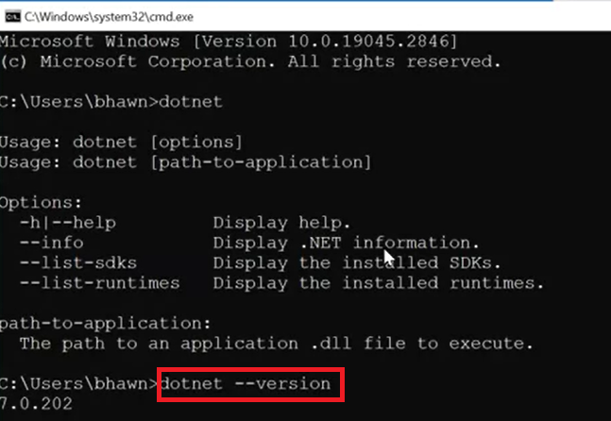
Step 2-You can check the version of .net by typing dotnet –version

Slide 4
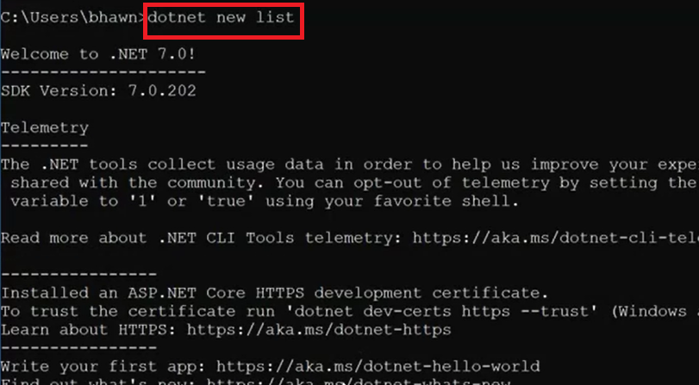
Step 3- The dotnet new list command lists available templates to use with dotnet new

Slide 5
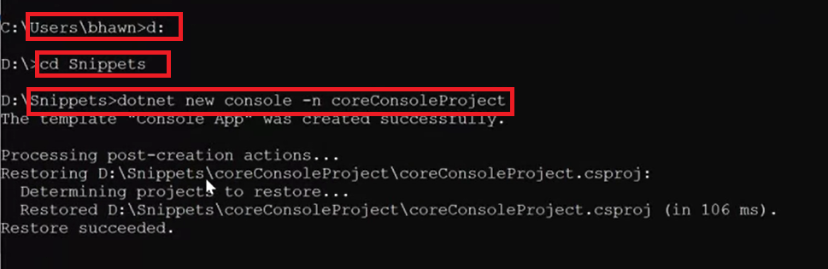
Step 4- Change drive(C is not recommended)/create one folder on d drive and then change path and then type dotnet new console
-n coreConsoleProject

Slide 6
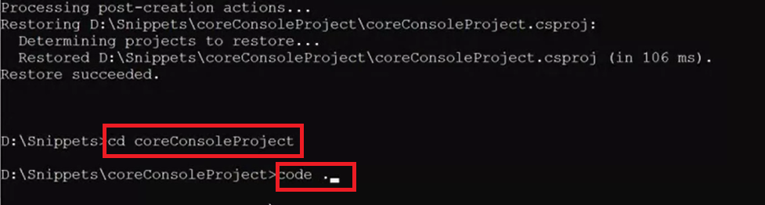
Step 5- change the path and get inside folder cd coreConsoleProject and then type code .c

Slide 7
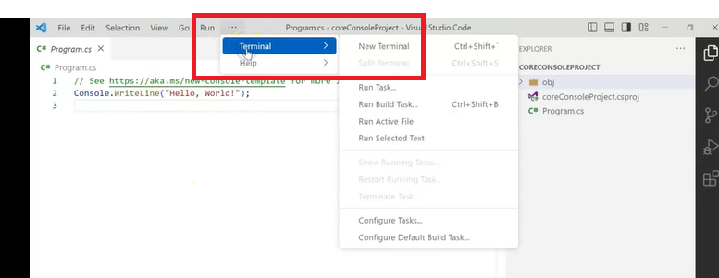
Step 6-Click on … besides run and then terminal and click on new terminal

Slide 8
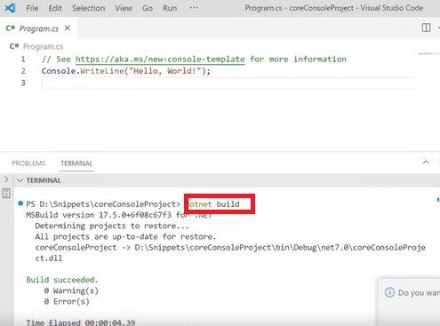
Step 7- Now write dotnet build

Slide 9
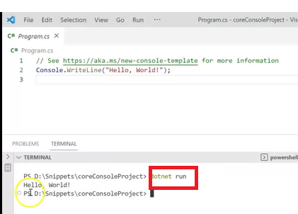
Step 8- finally write dotnet run

